Slide 1
JP Centre/South Main Streets
20th Annual Meeting
March 23, 2022

Slide 2
Agenda
7:00 - 7:30 PM - Refreshments and Networking
7:30 PM – Call to Order
Agenda
Welcome – Michael Reiskind, Board President
Financial Report
Featured Speaker - Segun Idowu, Chief of Economic Opportunity & Inclusion, City of Boston
Old Business
New Business
Upcoming Events in JP Centre/South
Text JPCSMS to 22828 to join our newsletter for updates.
8:30 PM - Refreshments and Networking

Slide 3
Welcome
Michael Reiskind, Board President, JP Centre/South Main Streets
Statement of Mission
Introduction of Board of Directors
Introduction of Ginger Brown, Executive Director
Introduction of Luis Ottonelli, Neighborhood Business Manager, City of Boston

Slide 4
Financial Report
JP Centre/South Main Streets Statement of Activity*
Revenue | $120,987.43
Expenditures | $91,797.92
Net Income | $29,189.51
JP Centre/South Main Streets Statement of Financial Position*
Total Assets | $66,336.58
Total Liabilities | $2,770.47
Total Equity | $63,566.11
Total Liabilities and Equity | $66,336.58
*as of 12/31/202
Accrual Basis

Slide 5
Featured Speaker - Segun Idowu
Chief of Economic Opportunity & Inclusion, City of Boston

Slide 6
Old Business
2021 Year in Review Video

Slide 8
Working Teams
Racial Equity and Justice Team
Economic Vitality Team
Design Team

Slide 9
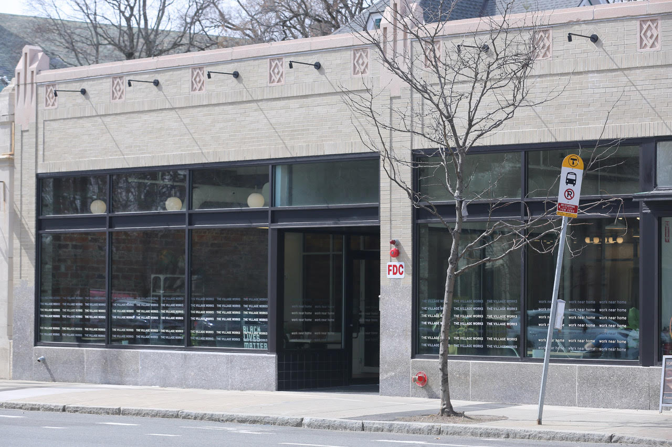
Renovated parapet at The Village Works, 769 Centre St

Slide 10
New Business
20th Anniversary of JP Centre/South Main Streets
Celebrations!

Slide 11
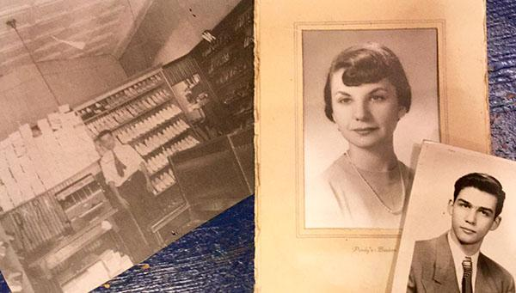
100 Years for
George’s Shoes
669 Centre Street

Slide 12
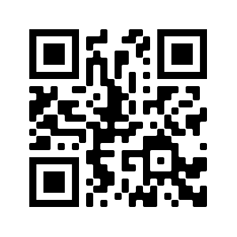
Scan for a history of
George’s Shoes
Susan Baroff, owner, on Chronicle, WCVB-TV.

Slide 13
Greater Boston’s Olmsted Bicentennial - Olmsted Now
Speaker Jen Mergel from Emerald Necklace Conservancy
olmstednow.org

Slide 14
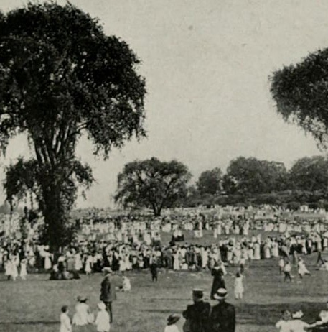
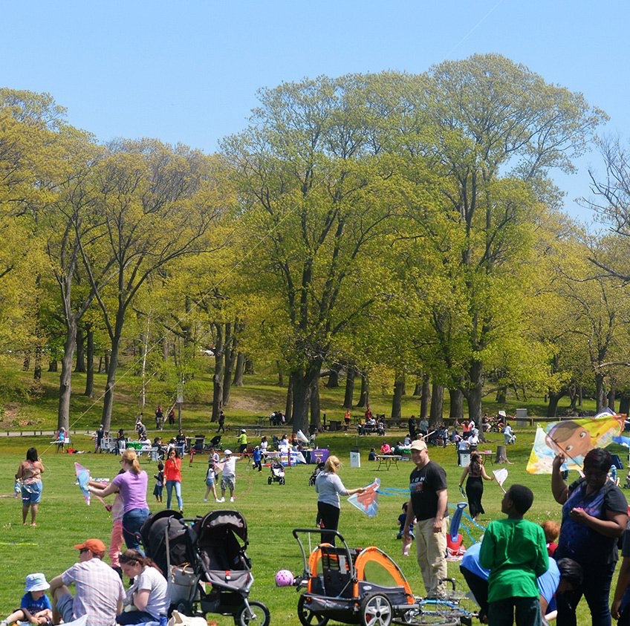
OLMSTED NOW
GREATER BOSTON’S OLMSTED BICENTENNIAL, 2022
Co-organized by the Emerald Necklace Conservancy (fiscal sponsor)
and Frederick Law Olmsted National Historic Site (national partner)
as part of the national bicentennial effort Olmsted 200.

Slide 15
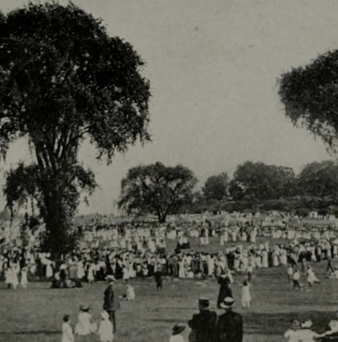
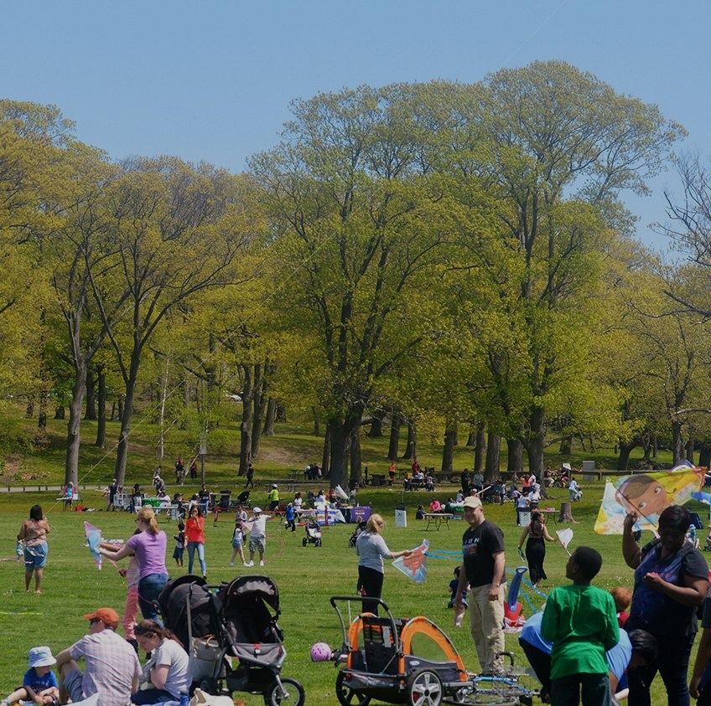
In 2022, Frederick Law Olmsted (b. April 26, 1822) turns 200. His visionary ideas and park designs in Boston and beyond are today’s platform to expand shared use, shared health and shared power in parks and public spaces–NOW.
Olmsted Now, Greater Boston's Olmsted Bicentennial, is the coalition & community-led platform to connect neighborhoods & organizations in making parks and public space more vibrant, verdant equitable & welcoming for all.
Olmsted Now, Greater Boston's Olmsted Bicentennial, is the coalition-led platform to connect communities and organizations in making parks and public space more vibrant, verdant and welcoming for all.
In 2022, Frederick Law Olmsted (b. April 26, 1822) will turn 200. His visionary ideas and park designs in Boston and beyond are today’s platform to expand shared use, shared health and shared power in parks and public spaces.

Slide 16
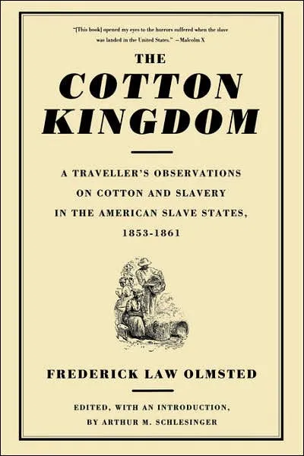
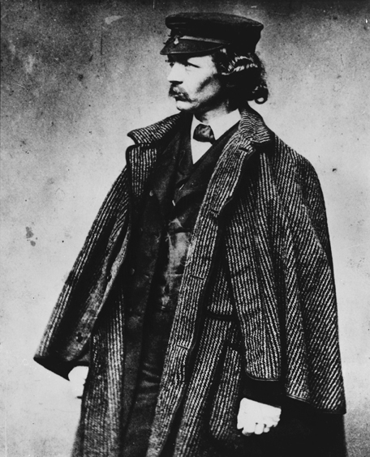
OLMSTED’s LEGACY
Notes:
Design, conservation, health and public discourse –all through the lens of JUSTICE

Slide 17
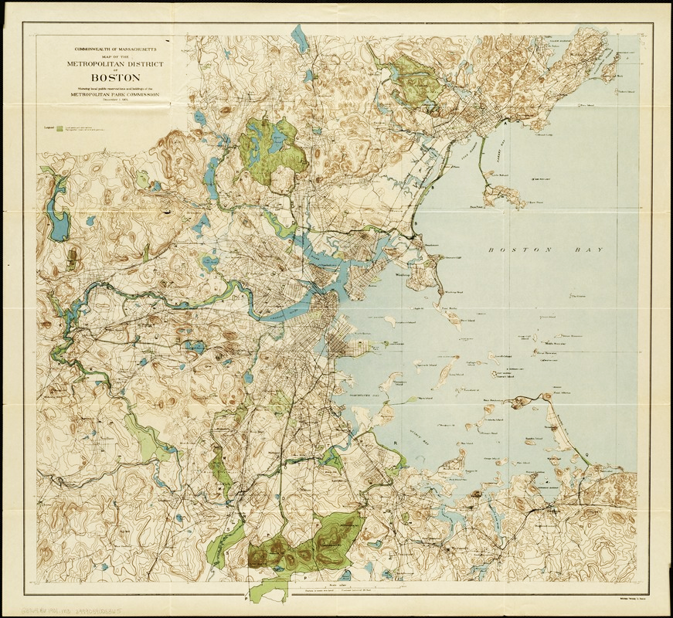
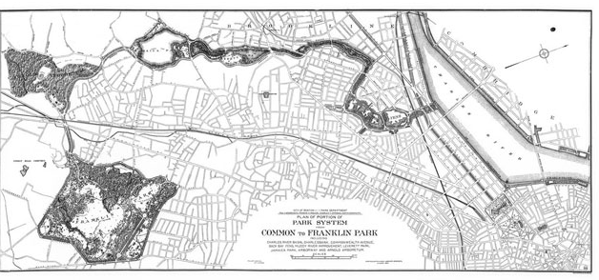
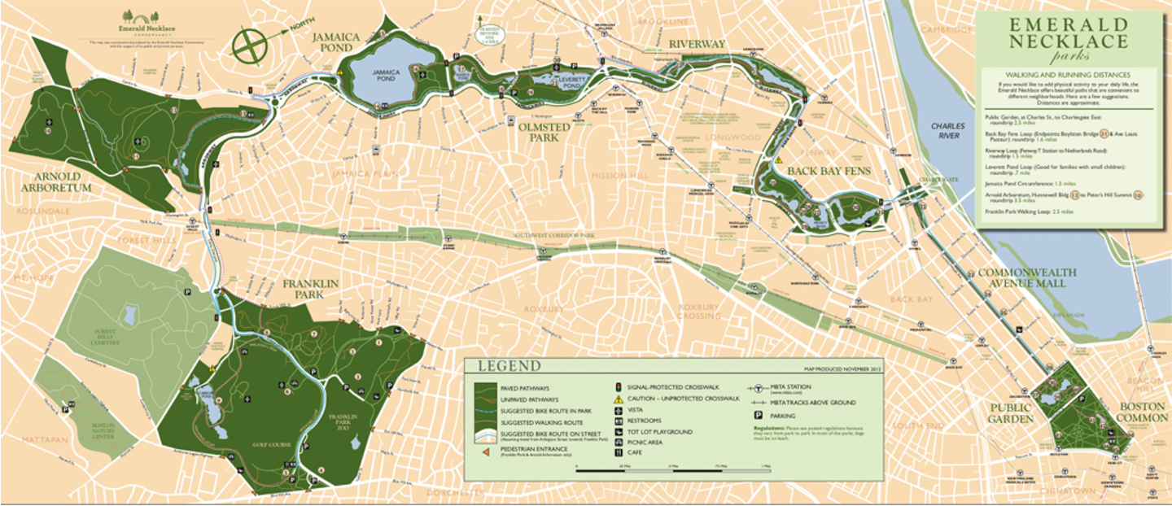
OLMSTED’s LEGACY: THE CULMINATION
Notes:
Ground zero, culmination of his visionary work.
The Emerald Necklace remains Boston’s vital connector, linking 1,100 acres of landmarked parks, parkways and waterways across over a dozen neighborhoods.
Since 1998, the Emerald Necklace Conservancy stewards the parks’ care and programming, collaborating with civic and neighborhood partners to connect people to and through parks

Slide 18
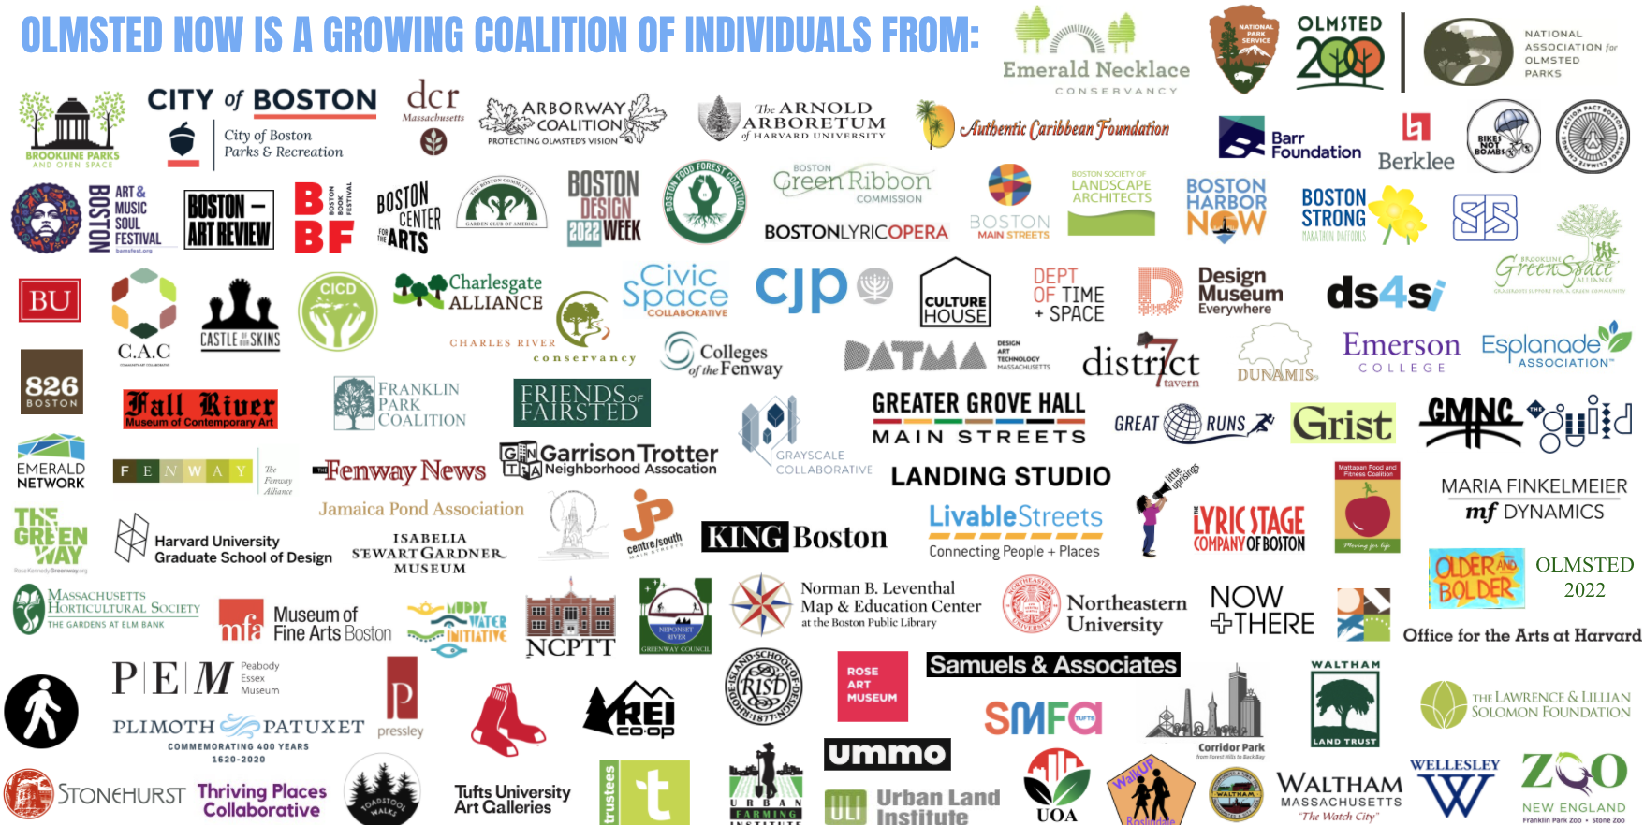
PARTNERSHIPS TO CHANGE HOW GREATER BOSTON COLLABORATES
COLLABORATE as a COALITION
> volunteers from 100+ local organizations within 60 miles of Boston: hyper local, regional, national
CONNECT
across DISCIPLINES
> reflect Olmsted’s legacy in many potential justice areas: social, racial, cultural, public and mental health, civic planning, policy and more.

Slide 19
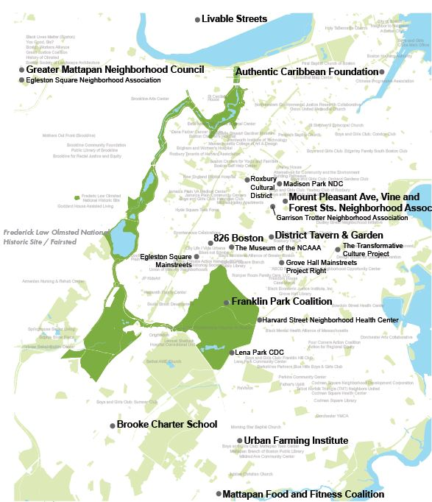
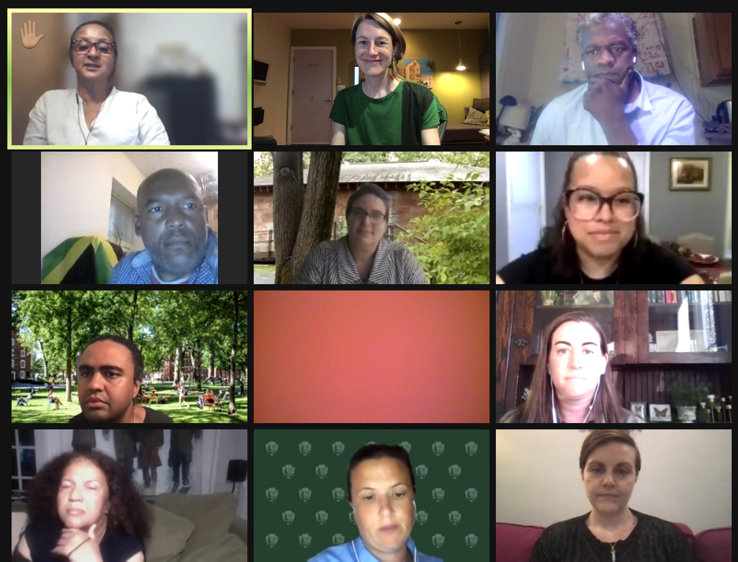
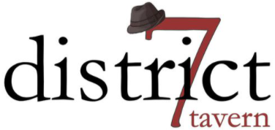
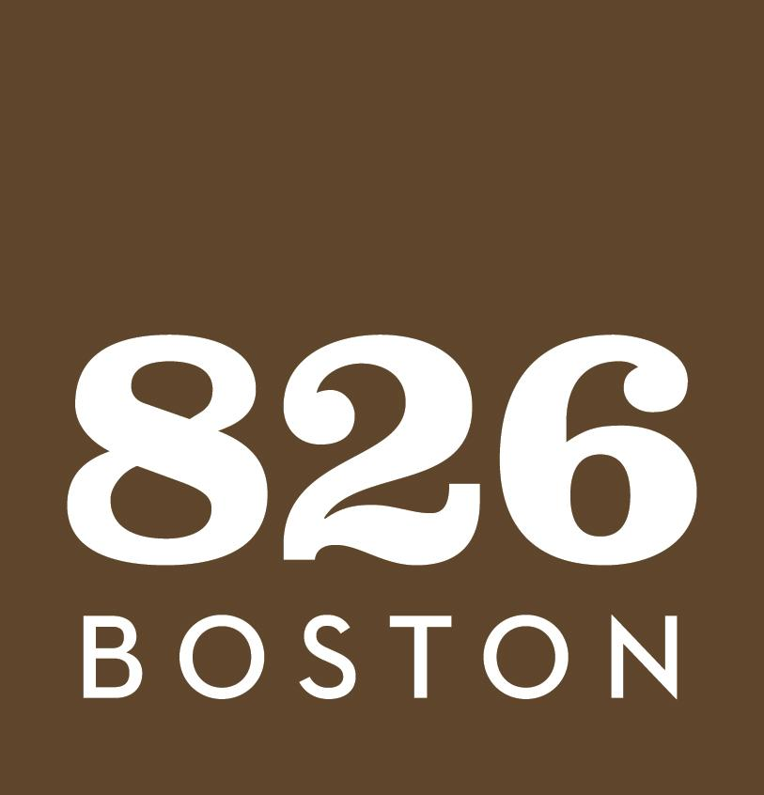
COMMITTEE OF NEIGHBORHOODS
Center Power in the Neighborhoods
> Community driven parks decision-making
> Trust to solicit programs, allocate funds
& strengthen networks from grassroots up.
> $200,000 to fund programming: April 20!

Slide 20
PUBLIC DIALOGUES
> Free Discussions guided by a community voice focused on Shared Use, Shared Health or Shared Power in Parks & Public Space through the lens of Justice, Equity, Diversity & Inclusion (JEDI).
> Monthly on 3rd Wednesday: 6-7pm on Zoom
> Register for the next Public Dialogue: April 20
> VIDEO of Public Dialogue #1

Slide 21
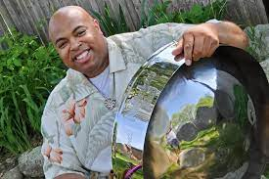
PARKS AS PLATFORM
For Olmsted Now, Greater Boston’s bicentennial of the birth of Frederick Law Olmsted, the Emerald Necklace Conservancy will expand its annual Summer on the Emerald Necklace series into a shared resource for Bicentennial partners to animate the Necklace parks with community-generated public events—Parks as Platform.
April 23 (24): Olmsted Park - Park Serve Day
May 8: Arnold Arboretum - Lilac Sunday
June 11 (12): Franklin Park - BAMS Fest
July 9 (10): Back Bay Fens - Fenway Porch Fest
August 20 (21): Jamaica Pond - JP Porch Fest
September 24 (25): FULL NECKLACE (PICNIC!)
October 1 (2): Charlesgate Park - Colleges

Slide 22
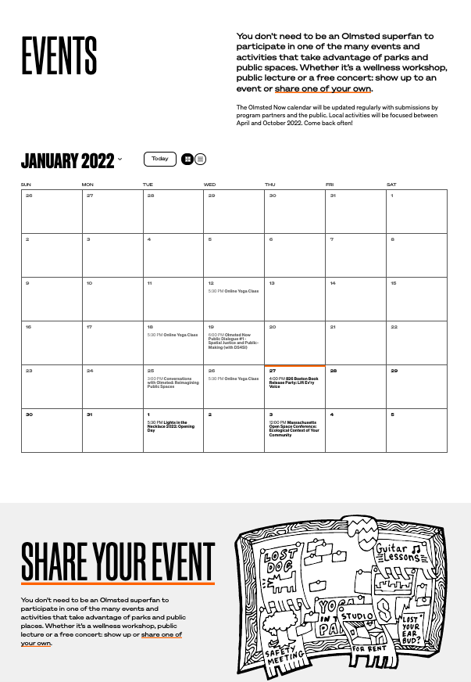
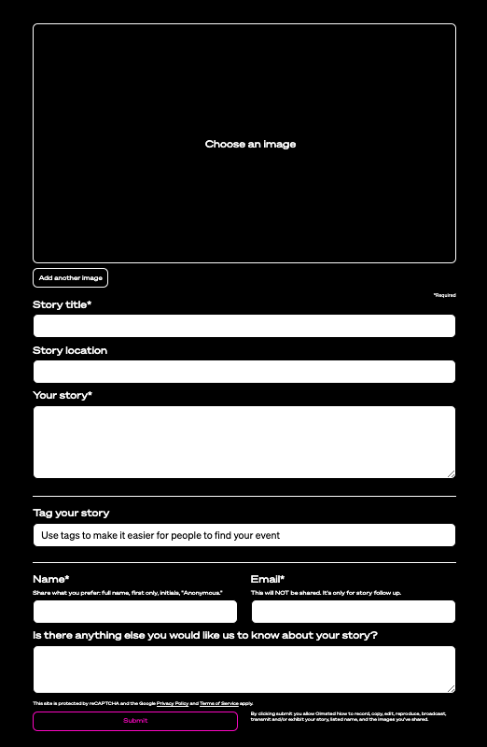
WAYS TO ENGAGE:
OFFER EVENTS & STORIES ONLINE www.olmstednow.org
FOLLOW INSTAGRAM
@olmstednow
MONTHLY E-NEWS bit.ly/OlmstedNowNews
SPREAD THE WORD!
ATTEND!
VOLUNTEER!

Slide 23
SAVE THE DATES :
TUES: APRIL 26 6:30-7:30
Olmsted 200th Birthday
JP Boathouse
SAT: AUGUST 20 (21)
Parks as Platform for
JP Porchfest
JP Boathouse
SAT: SEPTEMBER 24 (25)
Parks as Platform for
Parkwide Picnic!

Slide 24
Election of New Board Members

Slide 25
Vote for as many candidates as you prefer.
Nicole Gunn
Paul Stamatos
Write-In Candidates are allowed. Board Member terms are three (3) years.

Slide 26
Upcoming Events in JP Centre/South
Text JPCSMS to 22828 to join our newsletter for updates.
Uplift JP
Sat, April 16, 2022, 12:00-2:00 PM at Nckls & Dimes, 668 Centre St
JP Centre/South Main Streets Monthly Board Meeting
Wed, April 27, 2022, 5:00-6:00 PM via Zoom
JP Centre/South Spring Fundraiser
SAVE THE DATE! Tuesday, May 24, 2022
Taste and Tour – A Walk in the Neighborhood; a Guided FOOD Tour of Jamaica Plain with drinks and history highlights!
Entrepreneurial Education Fair
Thursday, June 9, 2022, 7:00-9:00 PM
Everything You Wanted to Know about Starting a Business (But Were Afraid to Ask)

